Slide 1
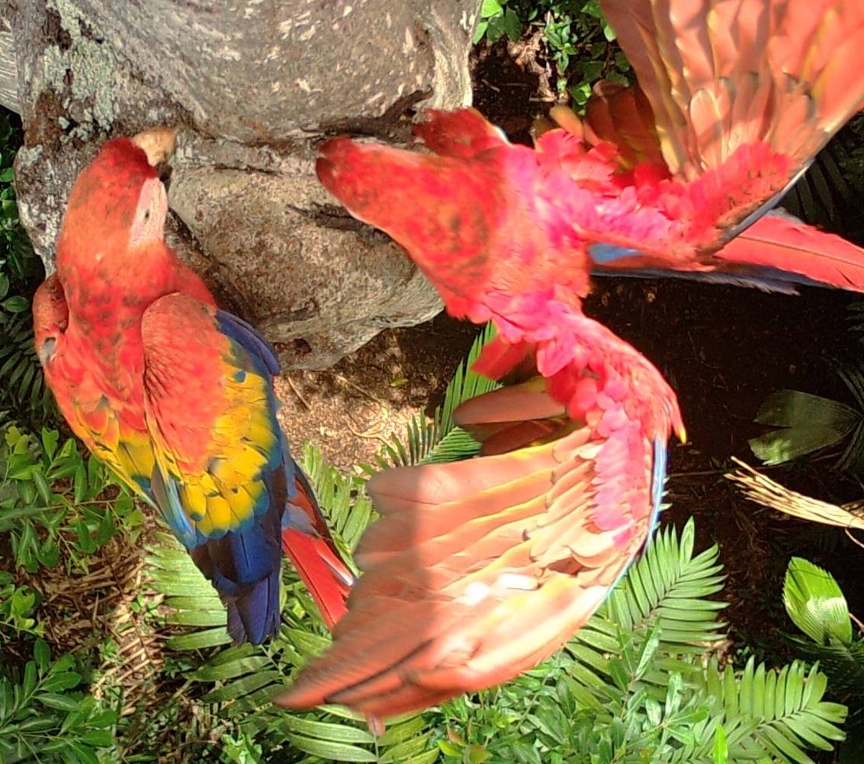
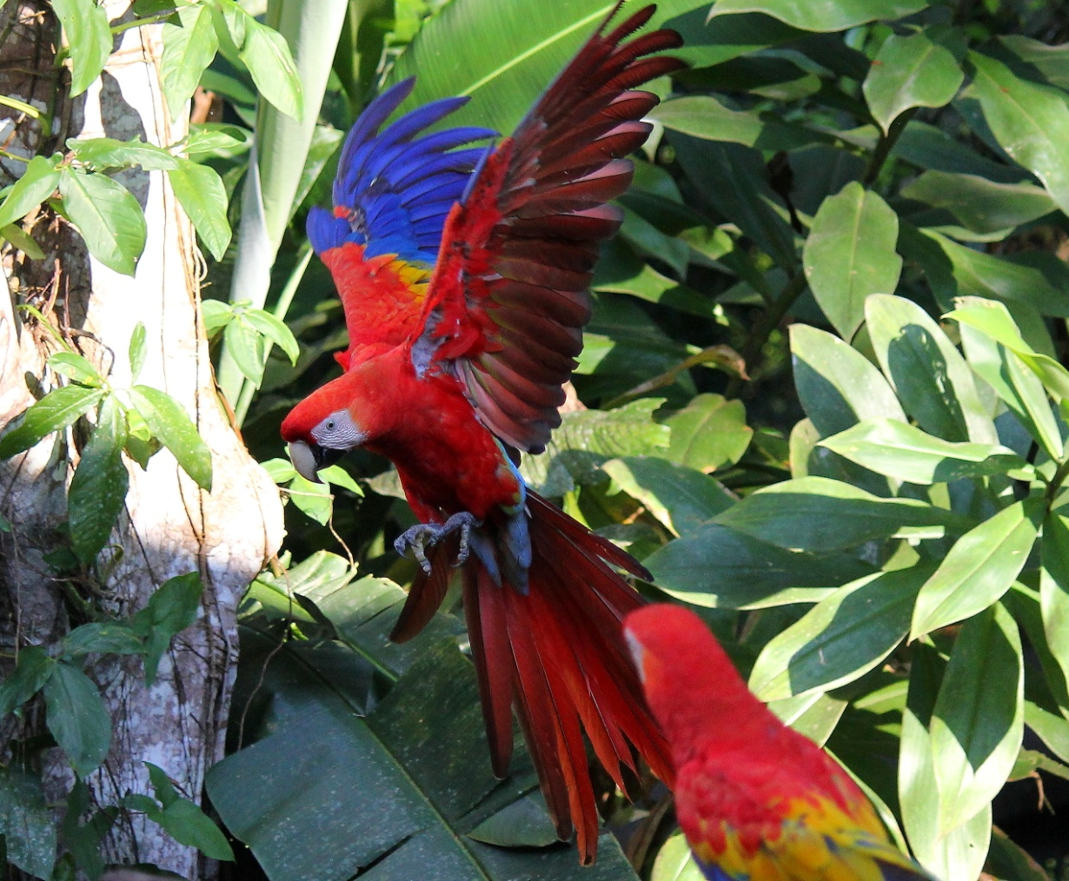
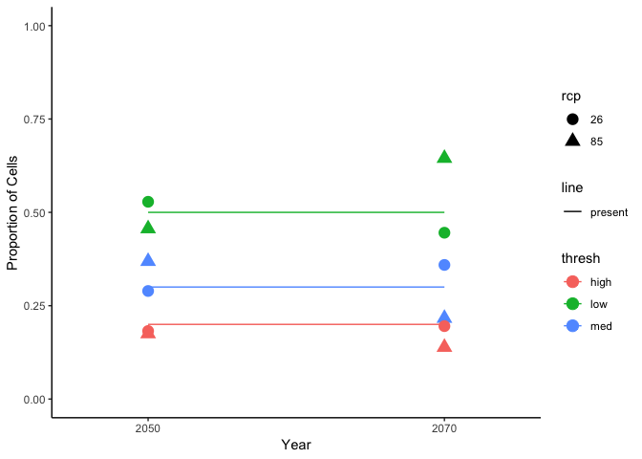
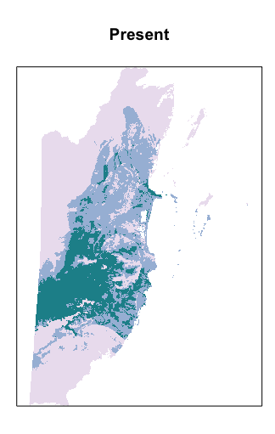
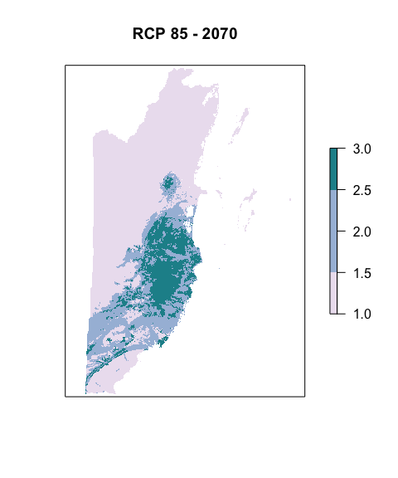
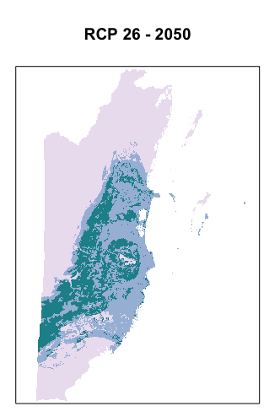
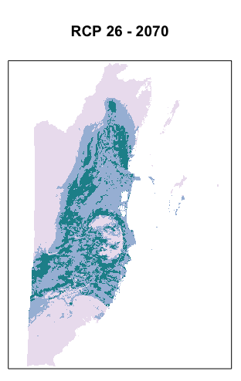
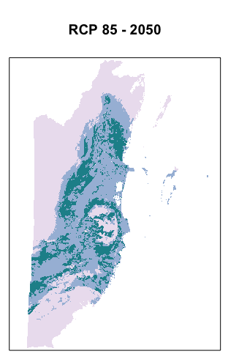
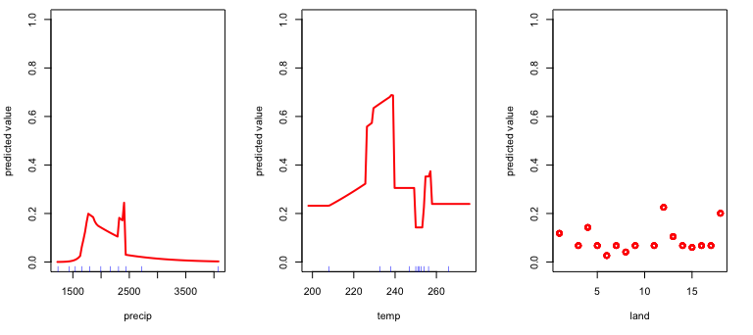
Predicting the spatial distribution of scarlet macaw (Ara macao cyanoptera) habitat under changing climate scenarios
Renata M. Diaz, Yichao Zeng, Boris M. Arevalo
Dept. of Wildlife Ecology and Conservation, University of Florida
INTRODUCTION
METHODS - Future Scenarios
RESULTS - Habitat Amount
Flagship species are key strategic tools for biodiversity conservation because they can ignite public interest and sympathy (Jepson and Barua 2015) - garnering support for conservation (Skibins et al. 2016), raising general biodiversity awareness, and securing conservation financing through philanthropy (Verissimo et al. 2011).
The scarlet macaw (Ara macao cyanoptera) is a flagship species for biodiversity conservation in Belize. The northern subspecies, A. macao cyanoptera, is endangered throughout its range, due to habitat loss and degradation and the pet trade (Iñigo-Elías 1996, Britt et al. 2014, Tella and Hiraldo 2014).
Understanding the spatial distribution of habitat for A. macao cyanoptera and how it may change under differing climate change scenarios will allow for better management and conservation of the species.
Comparing predictions across scenarios will help modelers gauge the sensitivity of biodiversity predictions to climate model assumptions.
Data:
Climate projections for 2050 and 2070 from BioClim, using the BCC-CSM1-1 model for two representative concentration pathways (RCP): RCP26 (least accumulation of CO2; least extreme) and RCP85 (most extreme).
Extracted mean annual temperature and mean annual precipitation.
Assumed no change in land cover.
Modeling:
Predicted occupancy probabilities for macaws according the selected model, using projected climate conditions as the environmental variables.
To facilitate comparison across scenarios, we divided cells into low, medium, and high-probability based on how they compared to the present-day predictions. “High” values were above the 85th percentile of present-day values, medium, the 50th to the 85th percentile, and low, below the 50th percentile.
We compared the proportion of cells falling into these categories according to different climate change scenarios.
Habitat Quality
The proportion of high-quality habitat decreases most dramatically under RCP 85. Moreover, under RCP 85, the proportion of low quality habitat increases much more than under RCP 26 by 2070.
Under RCP 26, the proportion of high quality habitat remains similar to the present. Some habitat changes from low to medium quality by 2070.
OBJECTIVES
CONCLUSIONS
Model the distribution of potential habitat for A. macao cyanoptera in Belize.
Explore changes in potential scarlet macaw habitat distribution across different climate change scenarios.
Evaluate the sensitivity of model outputs to chosen climate scenarios.
RESULTS - Habitat Distribution
Temperature and precipitation were the most important variables in predicting scarlet macaw suitable habitat.
The Maya Mountains Massif was identified as the best available scarlet macaw habitat, representing 20% of Belize.
Both the spatial distribution and amount of high and medium-quality habitat are sensitive to RCP scenario, with the most drastic reduction in habitat availability under the RCP 85 scenario.
Future efforts to model scarlet macaw habitat should consider a broader suite of environmental variables, and attempt to include projections for future land cover scenarios.
Temperature contributed most to the model (60%), followed by precipitation (30%) and land-cover (10%).
Potential scarlet macaw habitat suitability was highest in areas with annual precipitation of 1500-2500 mm, temperatures from 22-25 degrees C and in submontane broad-leaved moist forest, lowland broad-leaved moist forest, and riverine forest.
At present, high-quality habitat is concentrated on the Maya Mountains Massif.
Future climatic scenarios indicate a east-northeast shift in suitable habitat and becoming more fragmented especially under RCP85.
METHODS - Model Building
Quality
High (>85th)
Medium
(50th - 85th)
Low (<50th)
Data
Scarlet macaw sighting point data (n = 266, presence-only) collected along roads, tracks, trails and rivers in the Maya Mountains Massif protected area, Belize.
Environmental variables: mean annual temperature (WorldClim), mean annual precipitation (WorldClim), land-cover (Meerman & Clabaugh 2017), and elevation (ASTER DEM). Elevation was highly correlated with temperature (0.95) and removed.
Subset sighting points into training (n = 100) and test (n = 166) datasets.
Models
Fit MaxEnt species distribution models (maxent, Jurka and Tsuruoka 2013) on training data:
Unconstrained feature selection (Merow et al, 2013).
Beta = 0.01, 0.1, 0.5, 0.9, 1.
Best-performing model selected using Boyce’s criterion on models fit to test data.
The best-performing model (corr. = 0.987) had beta = 1, but all models had high correlation coefficients and gave qualitatively similar results.
REFERENCES
Britt, C. R., R. Gracía-Anleu, and M. J. Desmond. 2014. Nest survival of a long-lived psittacid: Scarlet Macaw (Ara macao cyanoptera) in the Maya Biosphere Reserve of Guatemala and Chiquibul Forest of Belize. The Condor 116(2):265-276.
Fick, S.E. and R.J. Hijmans. 2017. Worldclim 2: New 1-km spatial resolution climate surfaces for global land areas. International Journal of Climatology.
Iñigo-Elías, E. 1996. Ecology and breeding biology of the Scarlet macaw (Ara macao) in the Usumacinta drainage basin of Mexico and Guatemala. Dissertation, University of Florida, Gainesville, Florida, USA.
Jepson, P. and M. Barua. 2015. A theory of flagship species action. Conservation and Society 13(1):95-104.
Hijmans, R.J., S.E. Cameron, J.L. Parra, P.G. Jones and A. Jarvis, 2005. Very high resolution interpolated climate surfaces for global land areas. International Journal of Climatology 25: 1965-1978.
Meerman, J. and J. Clabaugh. 2017. Biodiversity and Environmental Resource Data System of Belize. <http://www.biodiversity.bz> Accessed 23 Oct 2018.
Merow, C. , Smith, M. J. and Silander, J. A. (2013), A practical guide to MaxEnt for modeling species’ distributions: what it does, and why inputs and settings matter. Ecography, 36: 1058-1069. doi:10.1111/j.1600-0587.2013.07872.x
NASA LP DAAC, 2011, ASTER GDEM Version 2. NASA EOSDIS Land Processes DAAC, USGS Earth Resources Observation and Science (EROS) Center, Sioux Falls, South Dakota <https://earthexplorer.usgs.gov/> accessed 23 Oct. 2018.
Timothy P. Jurka and Yoshimasa Tsuruoka (2013). Maxent: Low-memory Multinomial Logistic Regression with Support for Text Classification. R package version 1.3.3.1 https://CRAN.R-project.org/package=maxent
Skibins, J., R. Powell, and J. Hallo. 2016. Lucky 13: conservation implications of broadening "Big 5" flagship species recognition in East Africa. Journal of Sustainable Tourism 24(7):1024-1040.
Verissimo, D., D. C. MacMillan, and R. J. Smith. 2011. Towards a systematic approach for identifying conservation flagships. Conservation Letters 4:1-8.
Wiedenfeld, D. A. 1994. A new subspecies of Scarlet Macaw and its status and conservation. Ornitologia Neotropical 5:99–104.

